Slide 1
AHC - Academy

Slide 2
Method signatures
Method overload
Access modifiers

Slide 3
Method signature
A method signature is a unique identifier of a method on .Net compiler
It const of 2 parts method name and params.
public void MethodName(params)

Slide 4
Method overloading
Is a common way to implementing polymorphism, in this case the user can add or overload functionality on an existing method.
To achieve it we need to add another method with the same name but with different parameters (number of the parameters, order of the parameters, and data types of the parameters)

Slide 5
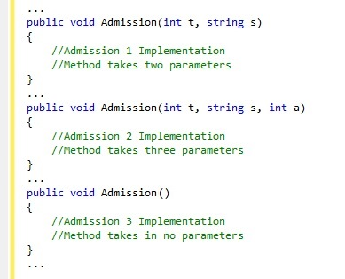
Method Overloading example

Slide 6
What are access modifiers?
Access modifiers in C# are used to specify the scope of accessibility of a member of a class or type of the class itself.
They implement encapsulation because they hide or show information depending of the access modifier that you’re using.

Slide 7
Access modifiers
public: Can be seen anywhere.
protected: Can be seen on the same class and derived classes.
private: Can be seen on the same class.
internal: Can be seen on the same assembly.
Protected internal: Can be accessed by any code in the assembly in which it's declared, or from within a derived class.

